Slide 1


GBME Probability and Statistics | Spring 2023
Lecture 01
Lecture 01
Course overview
CHOONG-WAN WOO | COCOAN lab | http://cocoanlab.github.io

Slide 2

Lecture 01
Introduction
Lab webpage
https://cocoanlab.github.io/
CHOONG-WAN WOO | COCOAN lab | http://cocoanlab.github.io

Slide 3
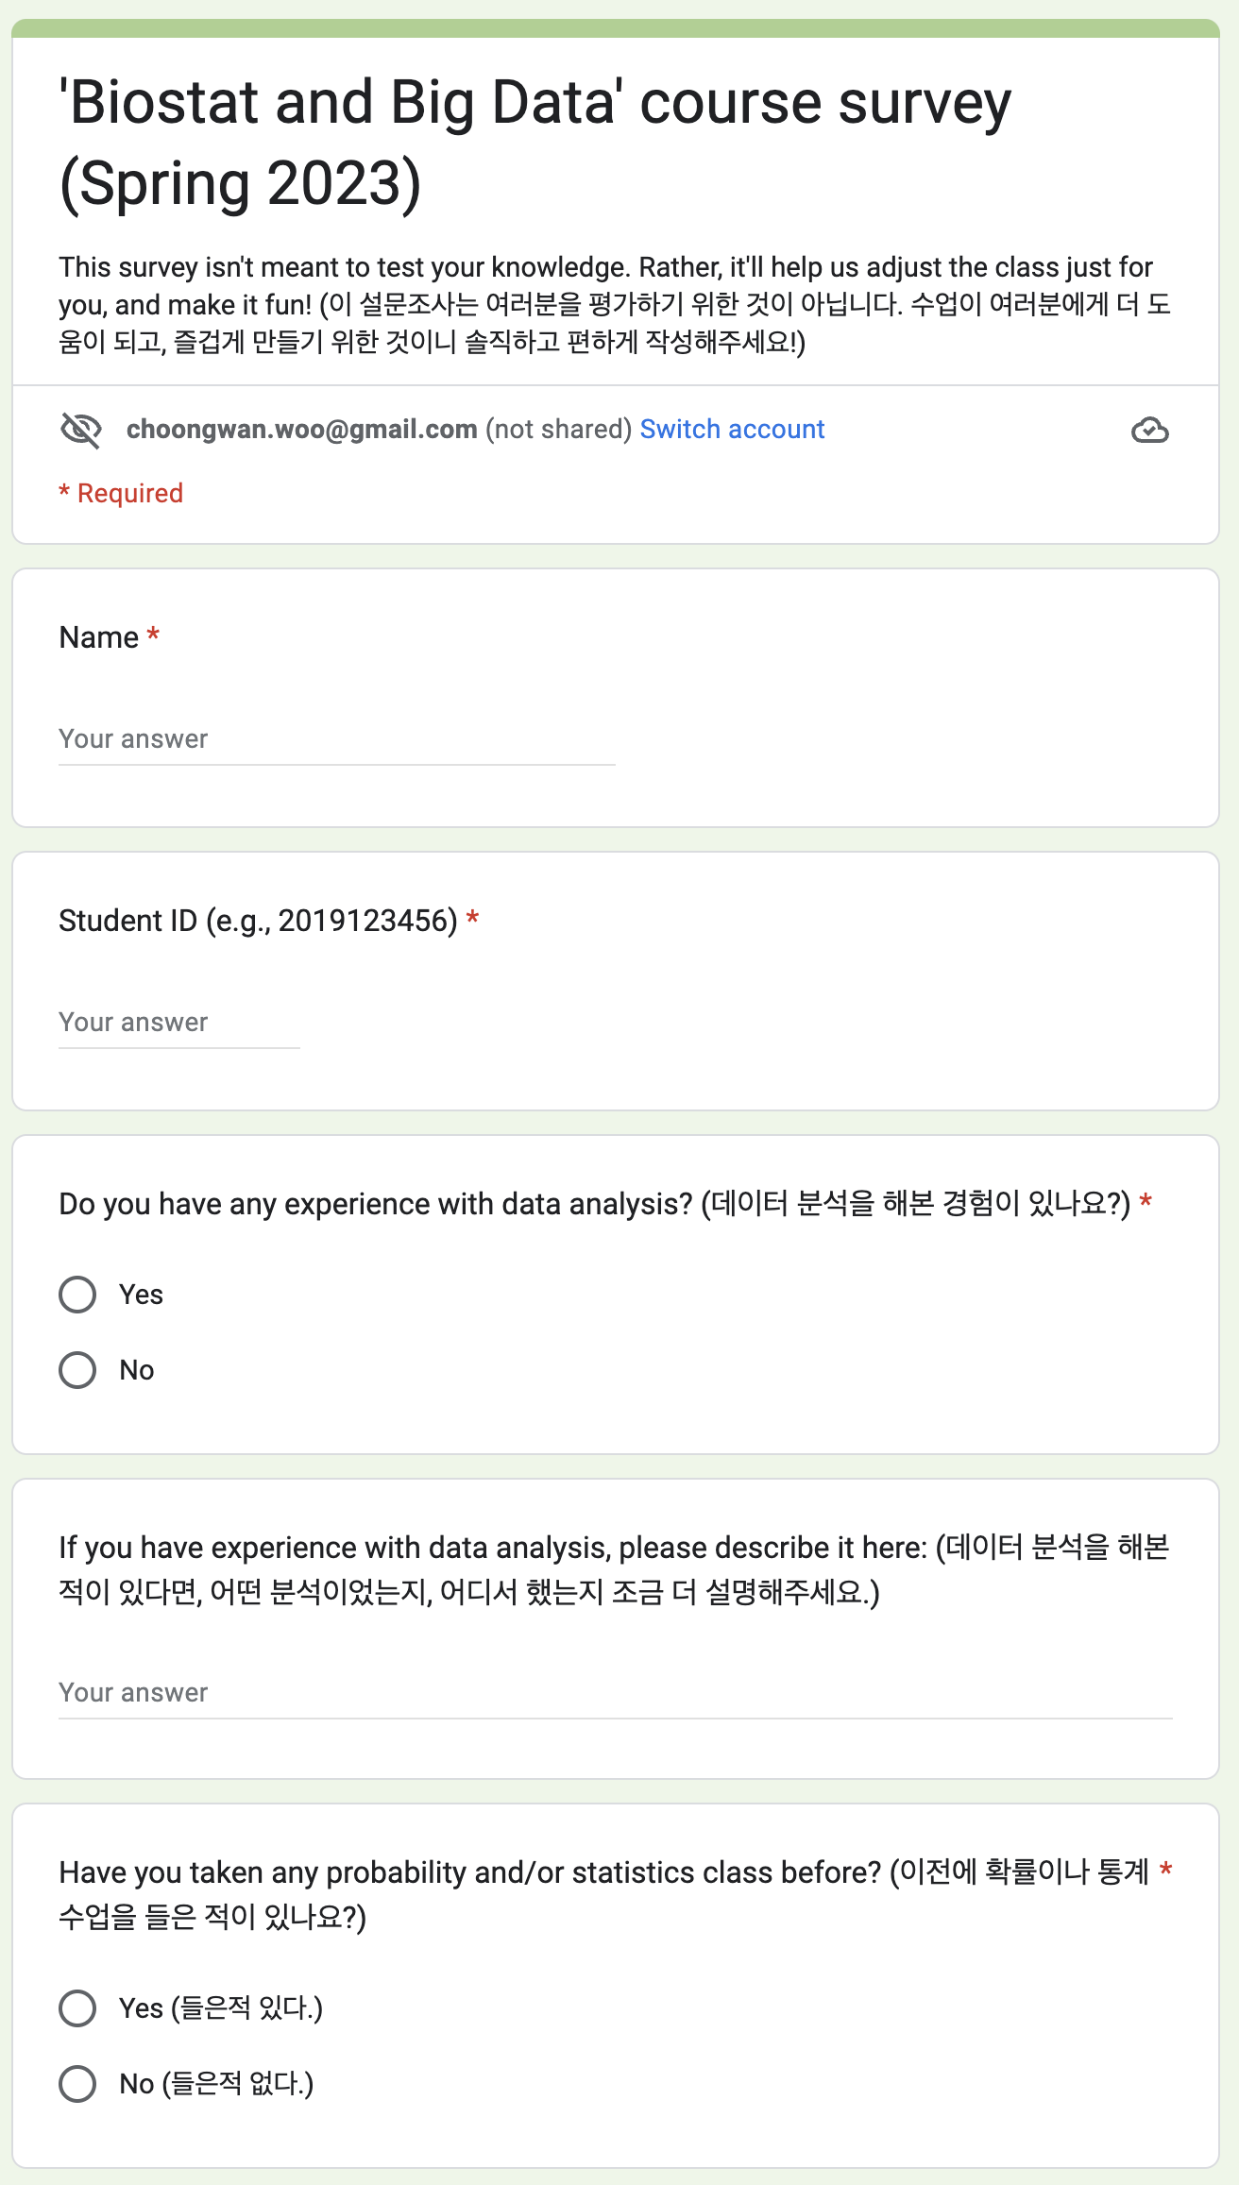
Lecture 01
Survey
Please complete this before next week class (3/6):
https://forms.gle/DRUuAU6gpFW9tBSc9
CHOONG-WAN WOO | COCOAN lab | http://cocoanlab.github.io

Slide 4
Lecture 01
Course overview
Biostats and Big data (previously GBME’s Probability and Statistics)
Class code: GBE 3064
Intro Stats
Textbook: "Stats: Data and Models" by De Veaux, Velleman, and Bock, Fourth Edition
Third edition also works!
CHOONG-WAN WOO | COCOAN lab | http://cocoanlab.github.io

Slide 5
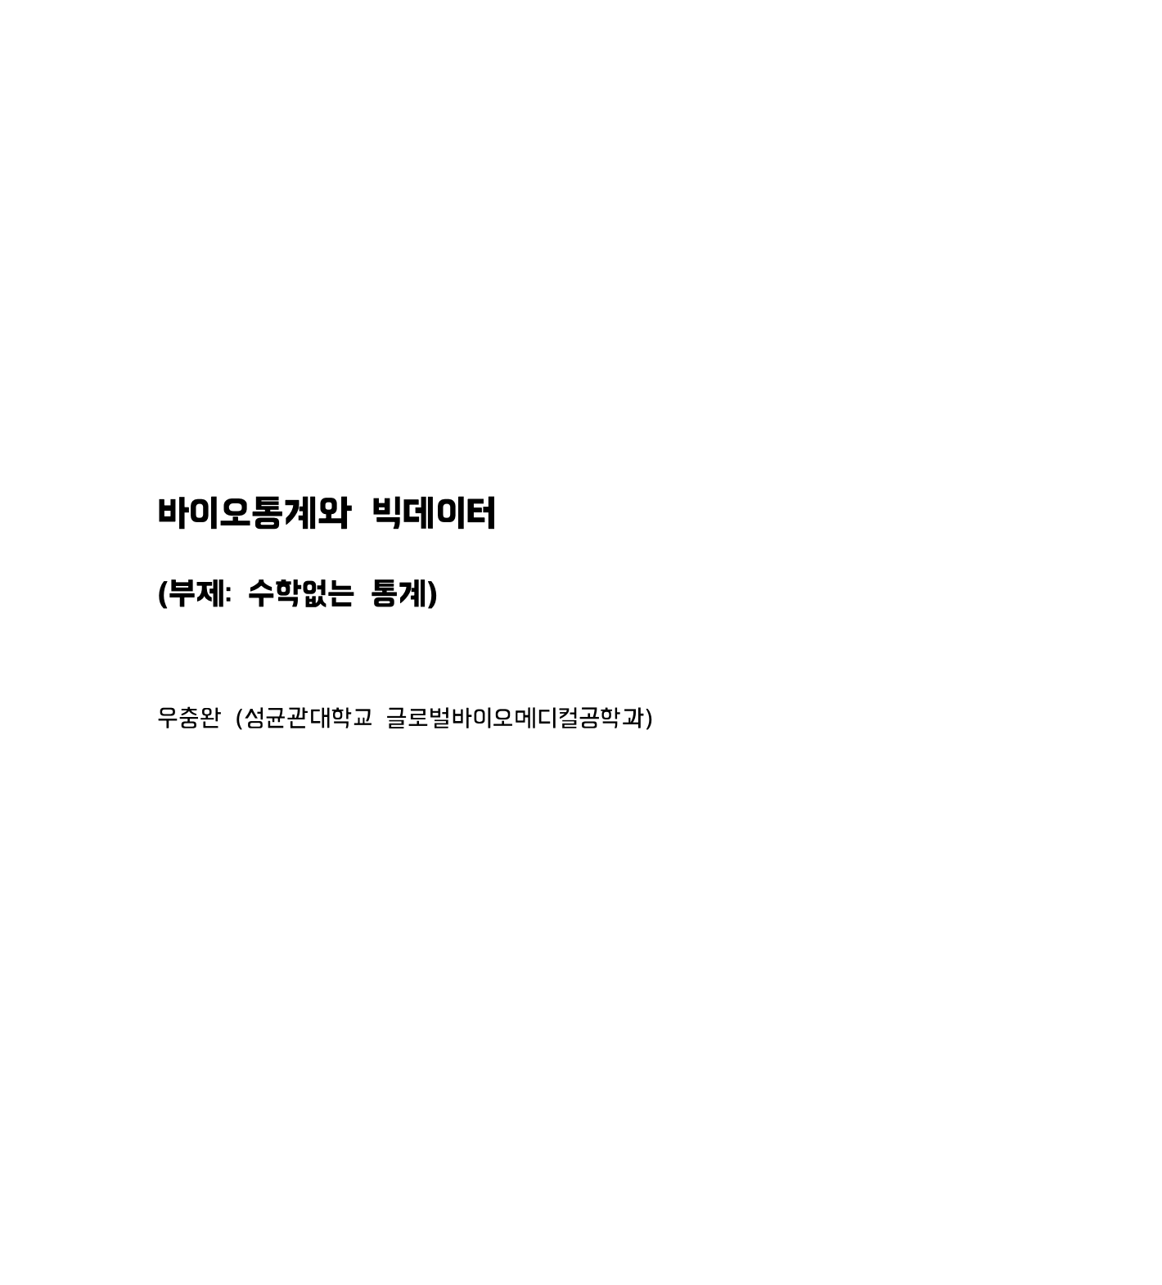
Lecture 01
Course overview
Biostats and Big data (previously GBME’s Probability and Statistics)
Class code: GBE 3064
Intro Stats
Textbook: "Stats: Data and Models" by De Veaux, Velleman, and Bock, Fourth Edition
Third edition also works!
And I recently wrote a textbook in Korean
I am sharing this for free!
Download: https://tinyurl.com/4kdx8thf
No cover, no design yet.. (if you want to help with the book design, let me know. ☺ )
CHOONG-WAN WOO | COCOAN lab | http://cocoanlab.github.io

Slide 6
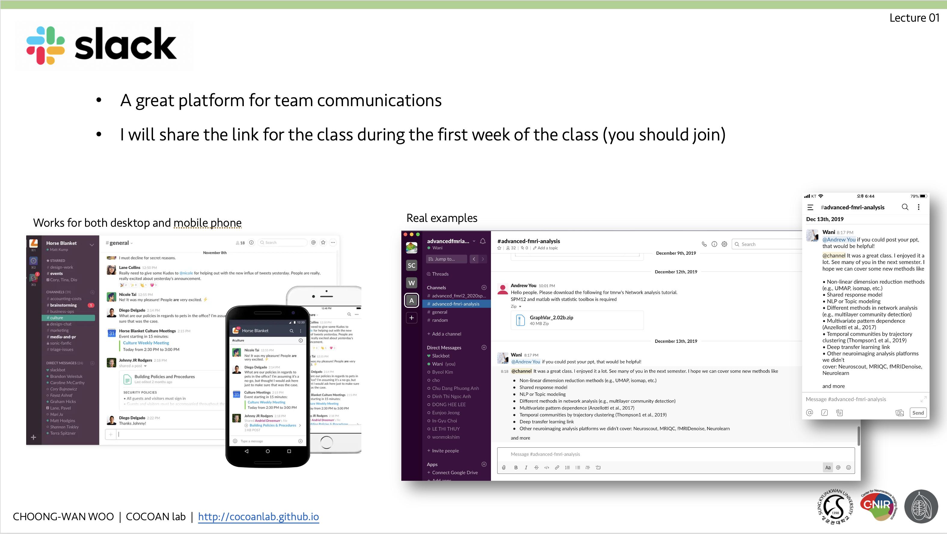
Lecture 01
For communications!
Previously, I used
But this semester, I will try the icampus.. Not sure what would be better..
What do you think?
CHOONG-WAN WOO | COCOAN lab | http://cocoanlab.github.io

Slide 7
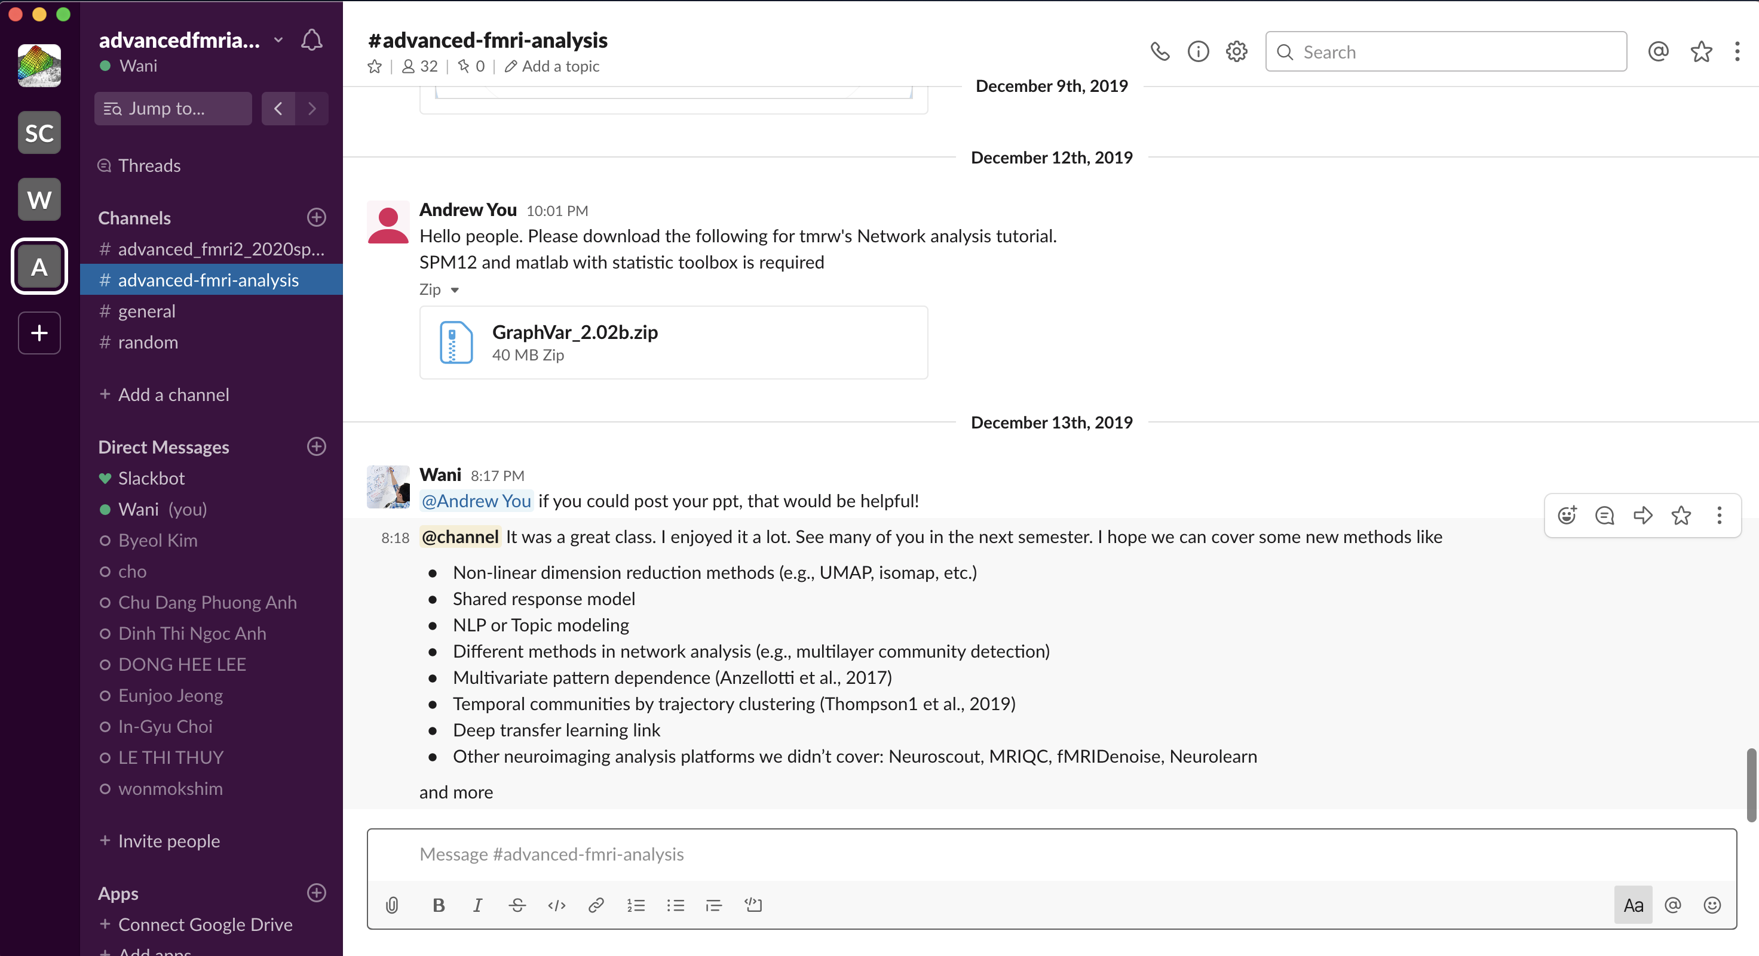
Lecture 01
A great platform for team communications
I will share the link for the class during the first week of the class (you should join)
Works for both desktop and mobile phone
Real examples
CHOONG-WAN WOO | COCOAN lab | http://cocoanlab.github.io

Slide 8
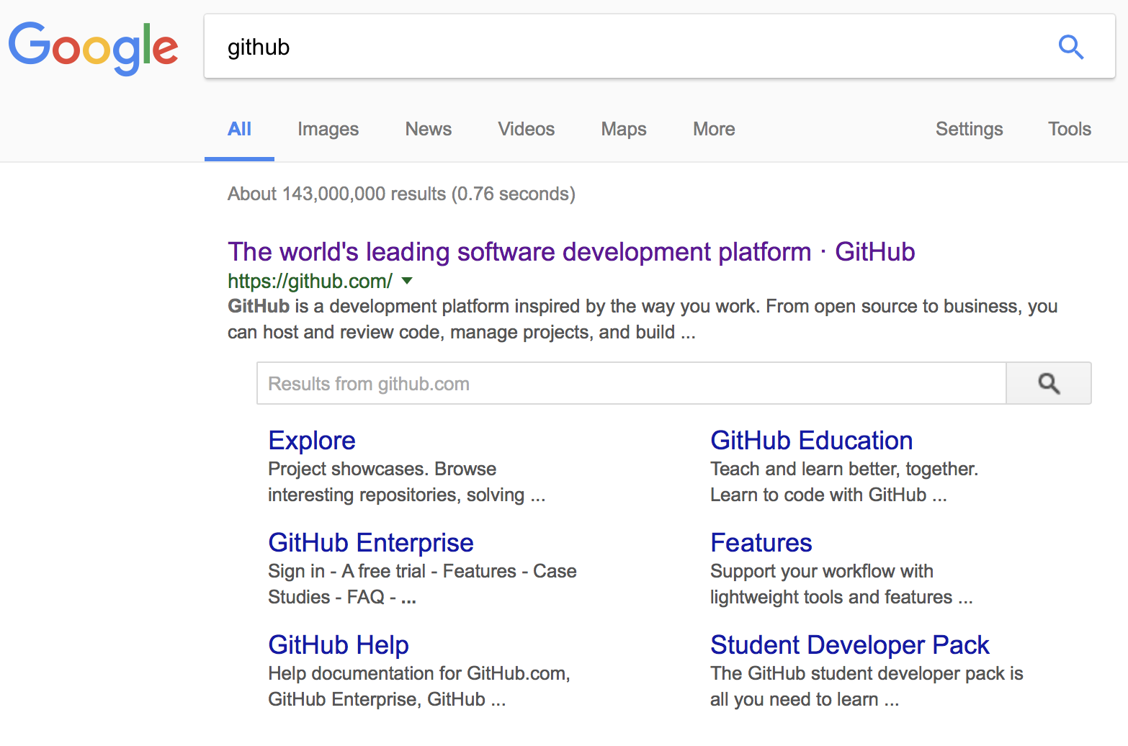
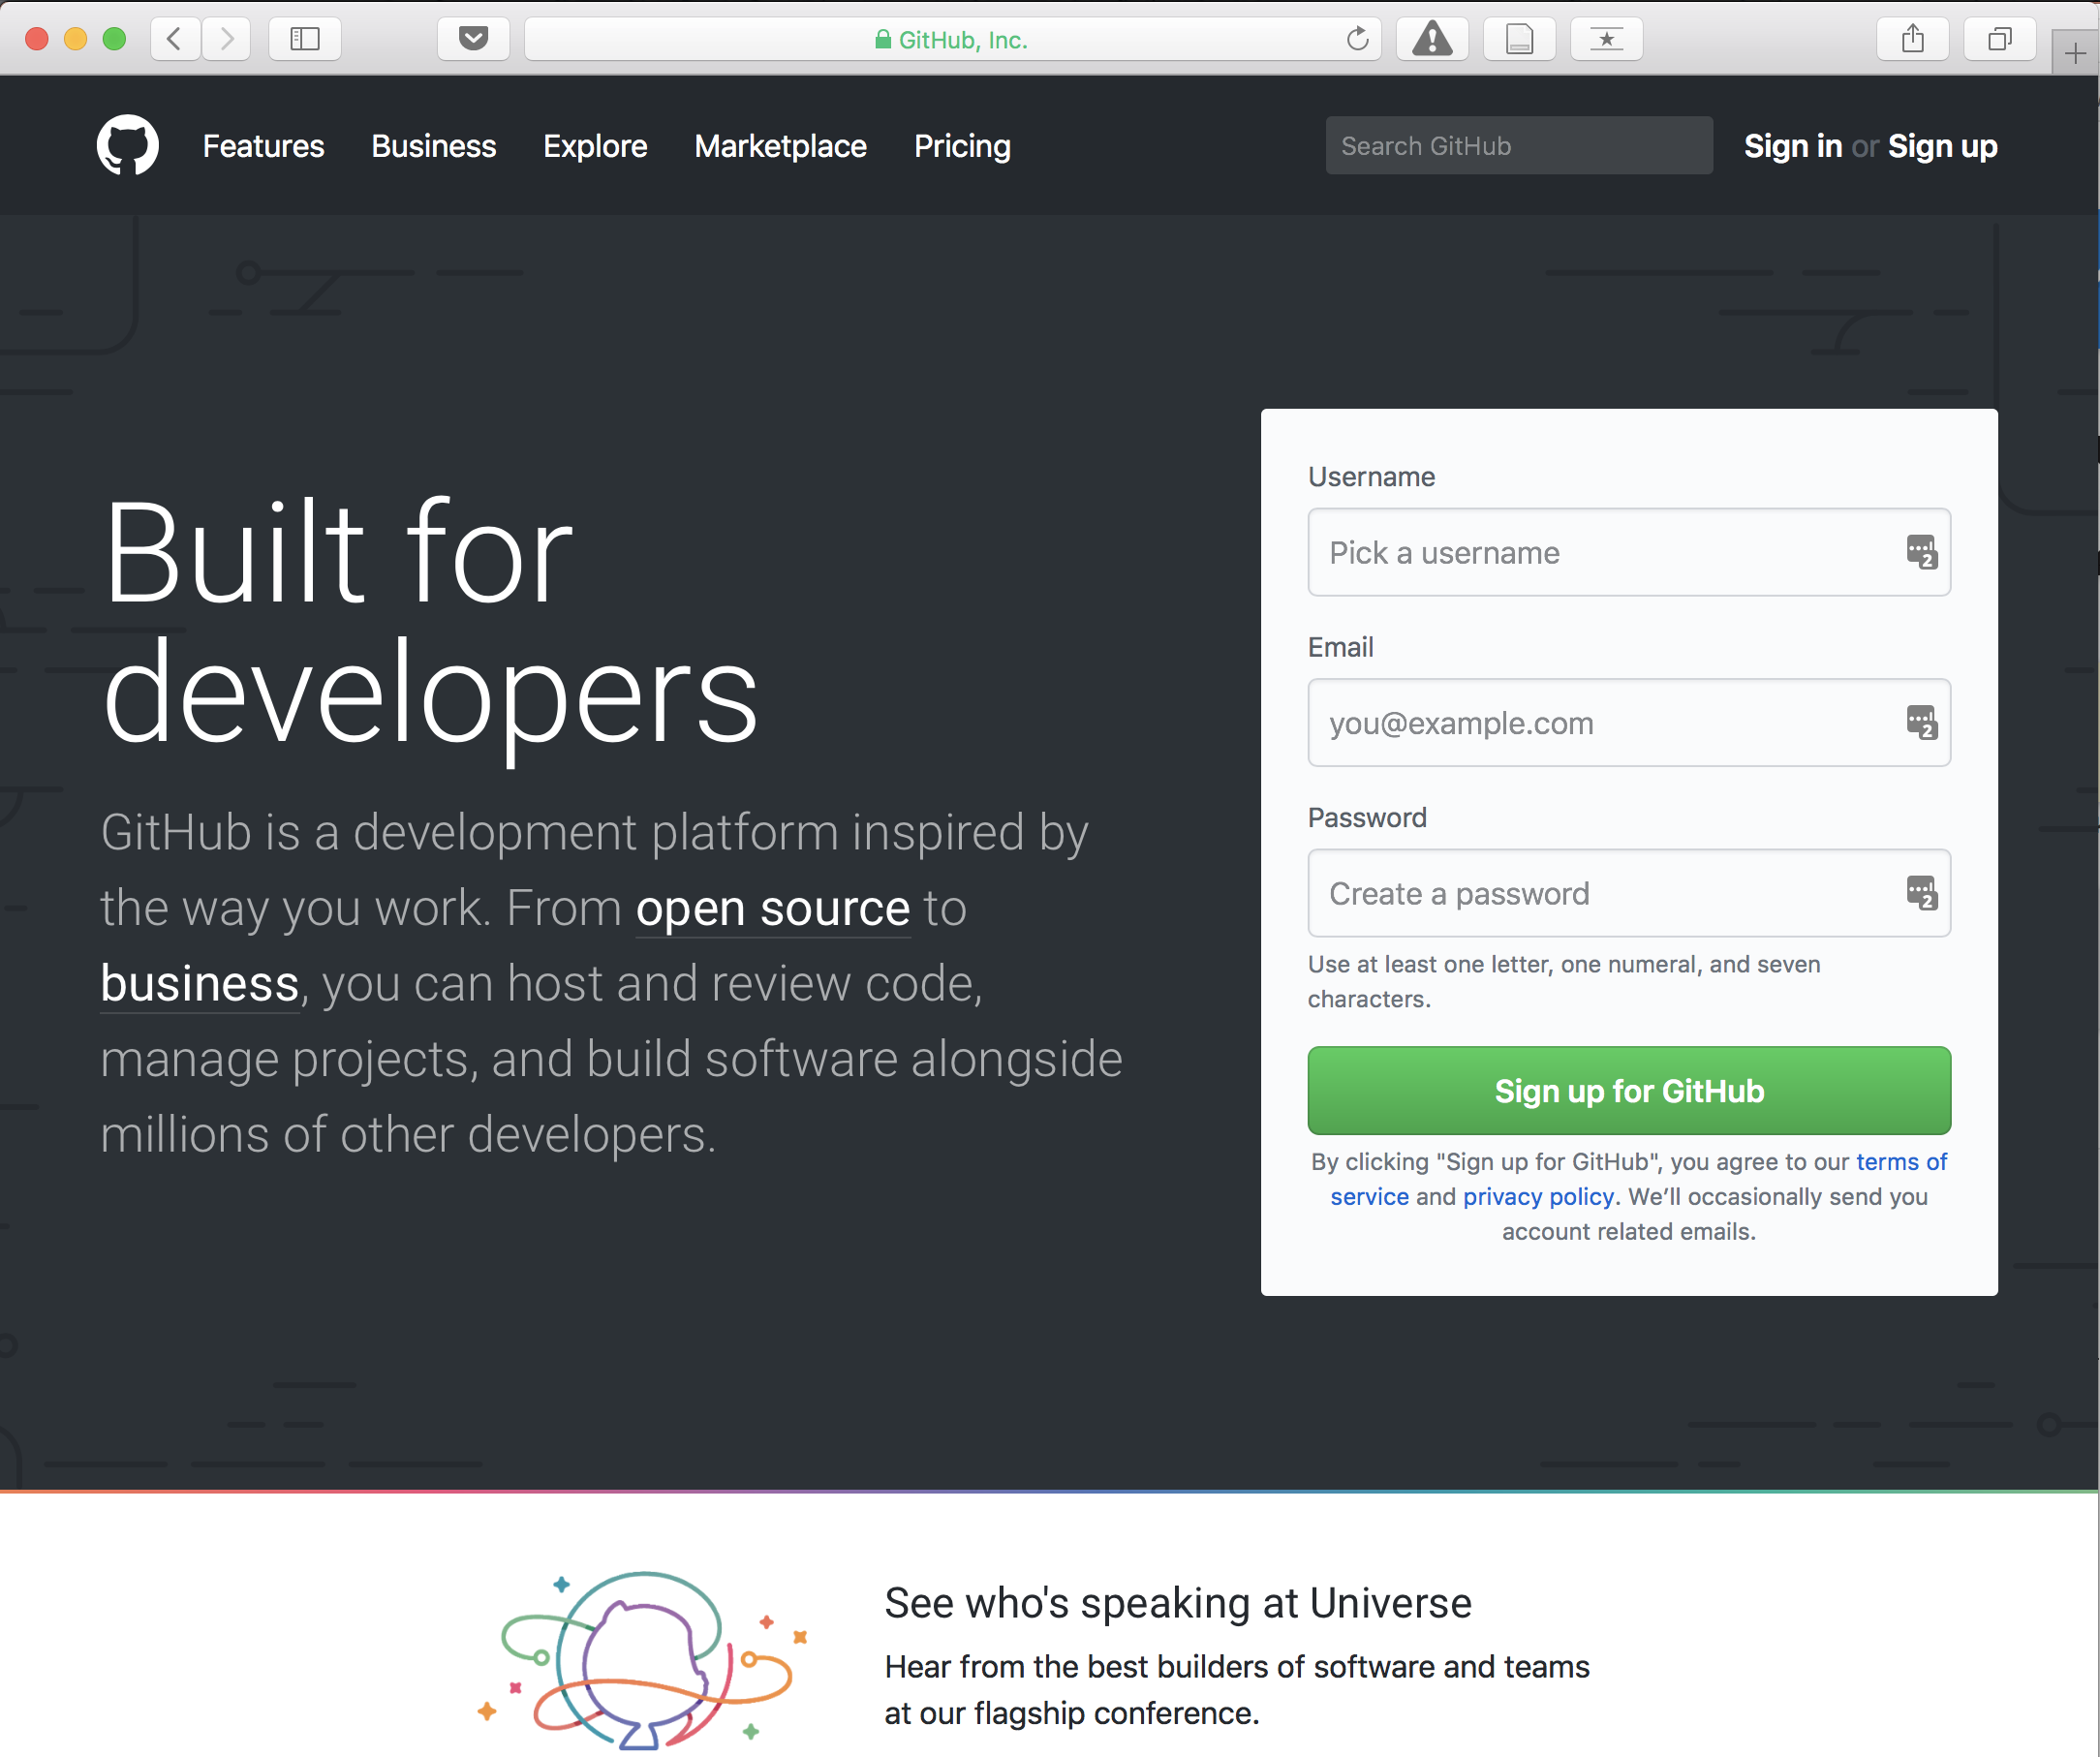
Lecture 01
For syllabus and files!
Most popular software development platform: version control, easy-sharing scripts and data, etc.
CHOONG-WAN WOO | COCOAN lab | http://cocoanlab.github.io

Slide 9
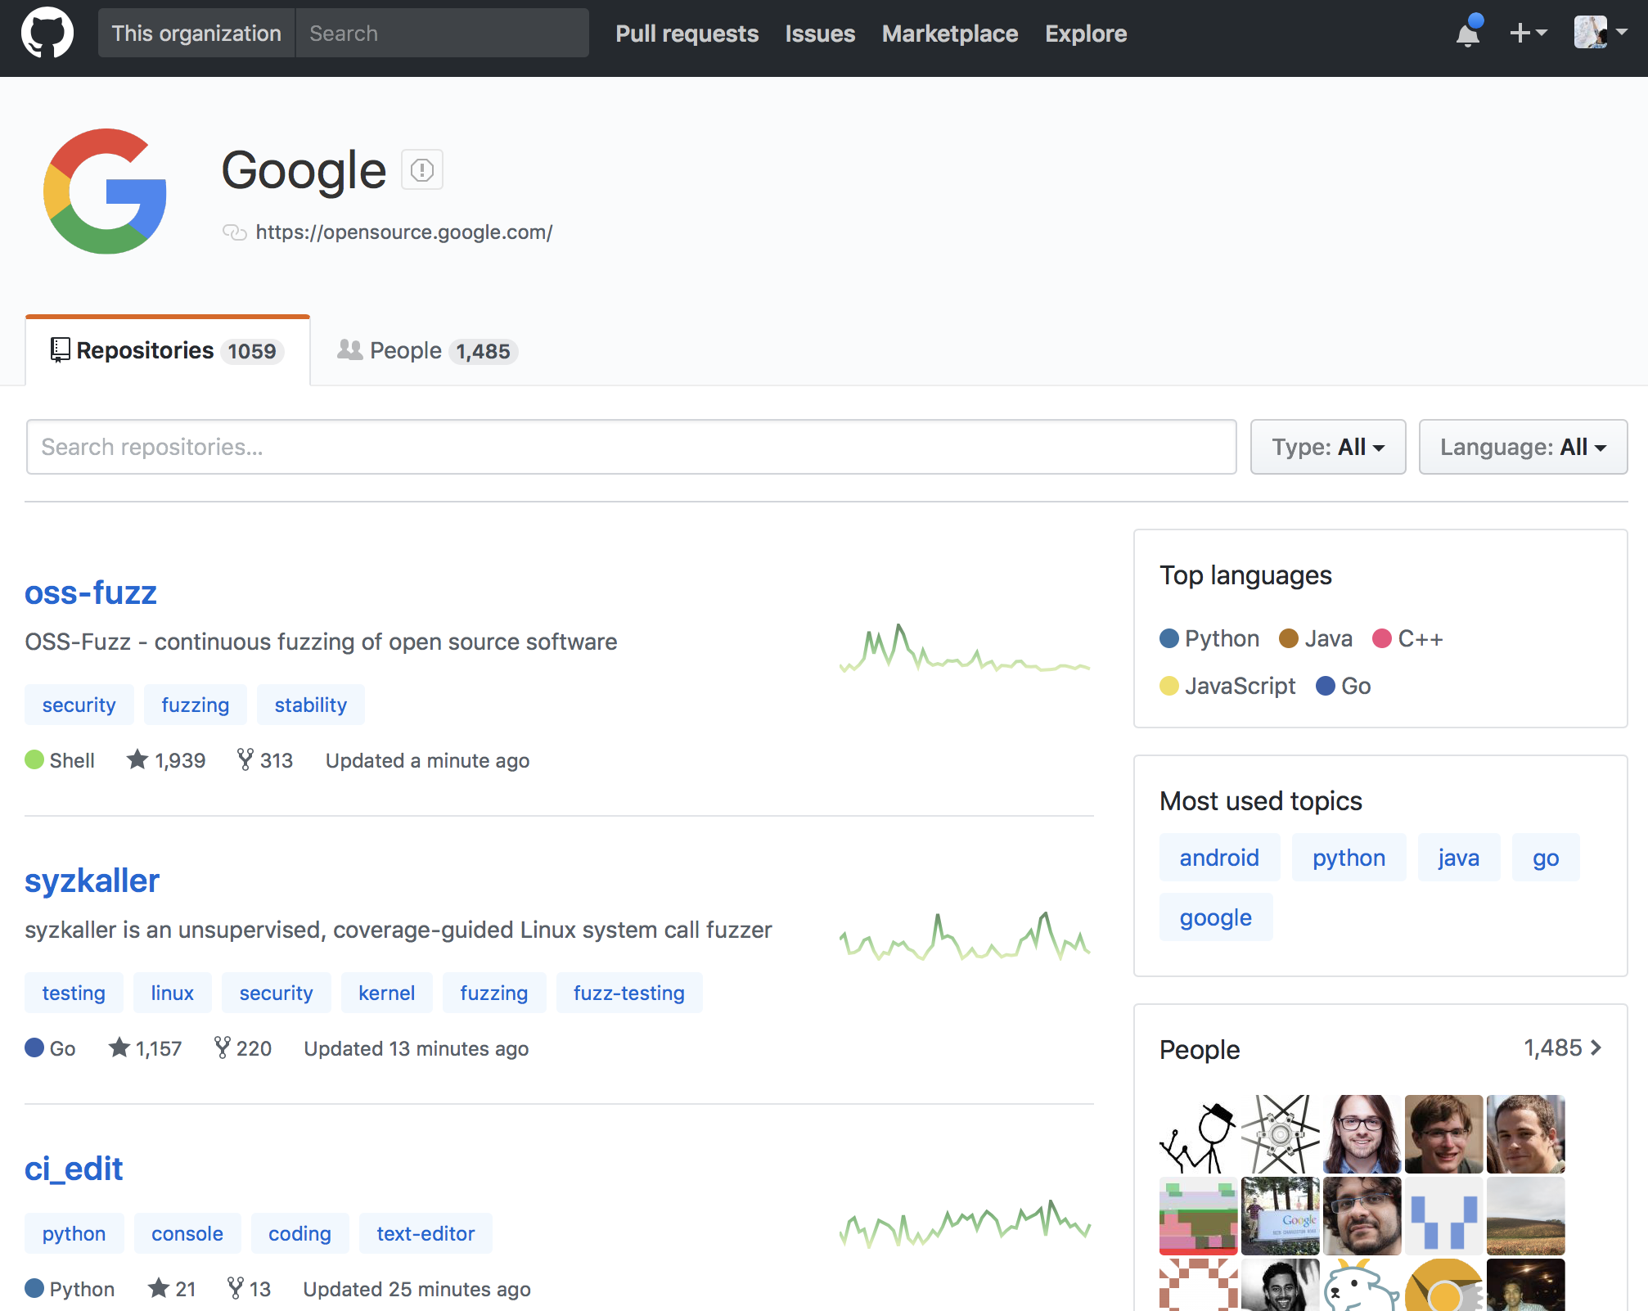
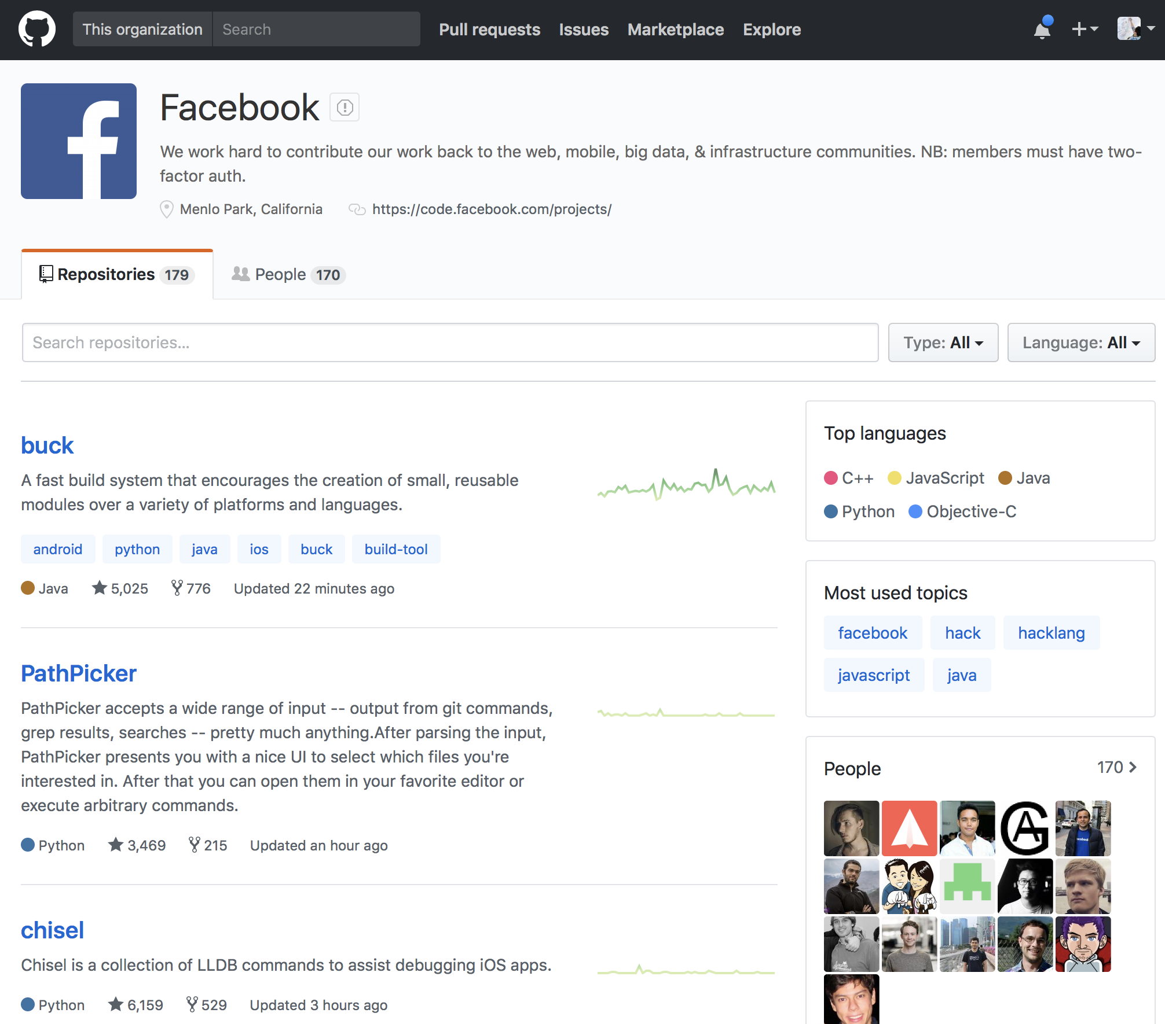
Lecture 01
For syllabus and files!
Most popular software development platform: version control, easy-sharing scripts and data, etc.
Everyone uses GitHub for the development, including Google, Facebook, etc.
CHOONG-WAN WOO | COCOAN lab | http://cocoanlab.github.io

Slide 10
Lecture 01
For syllabus and files!
Most popular software development platform: version control, easy-sharing scripts and data, etc.
Everyone uses GitHub for the development, including Google, Facebook, etc.
More and more people are creating and sharing a GitHub repository for their research and publications:
CHOONG-WAN WOO | COCOAN lab | http://cocoanlab.github.io

Slide 11

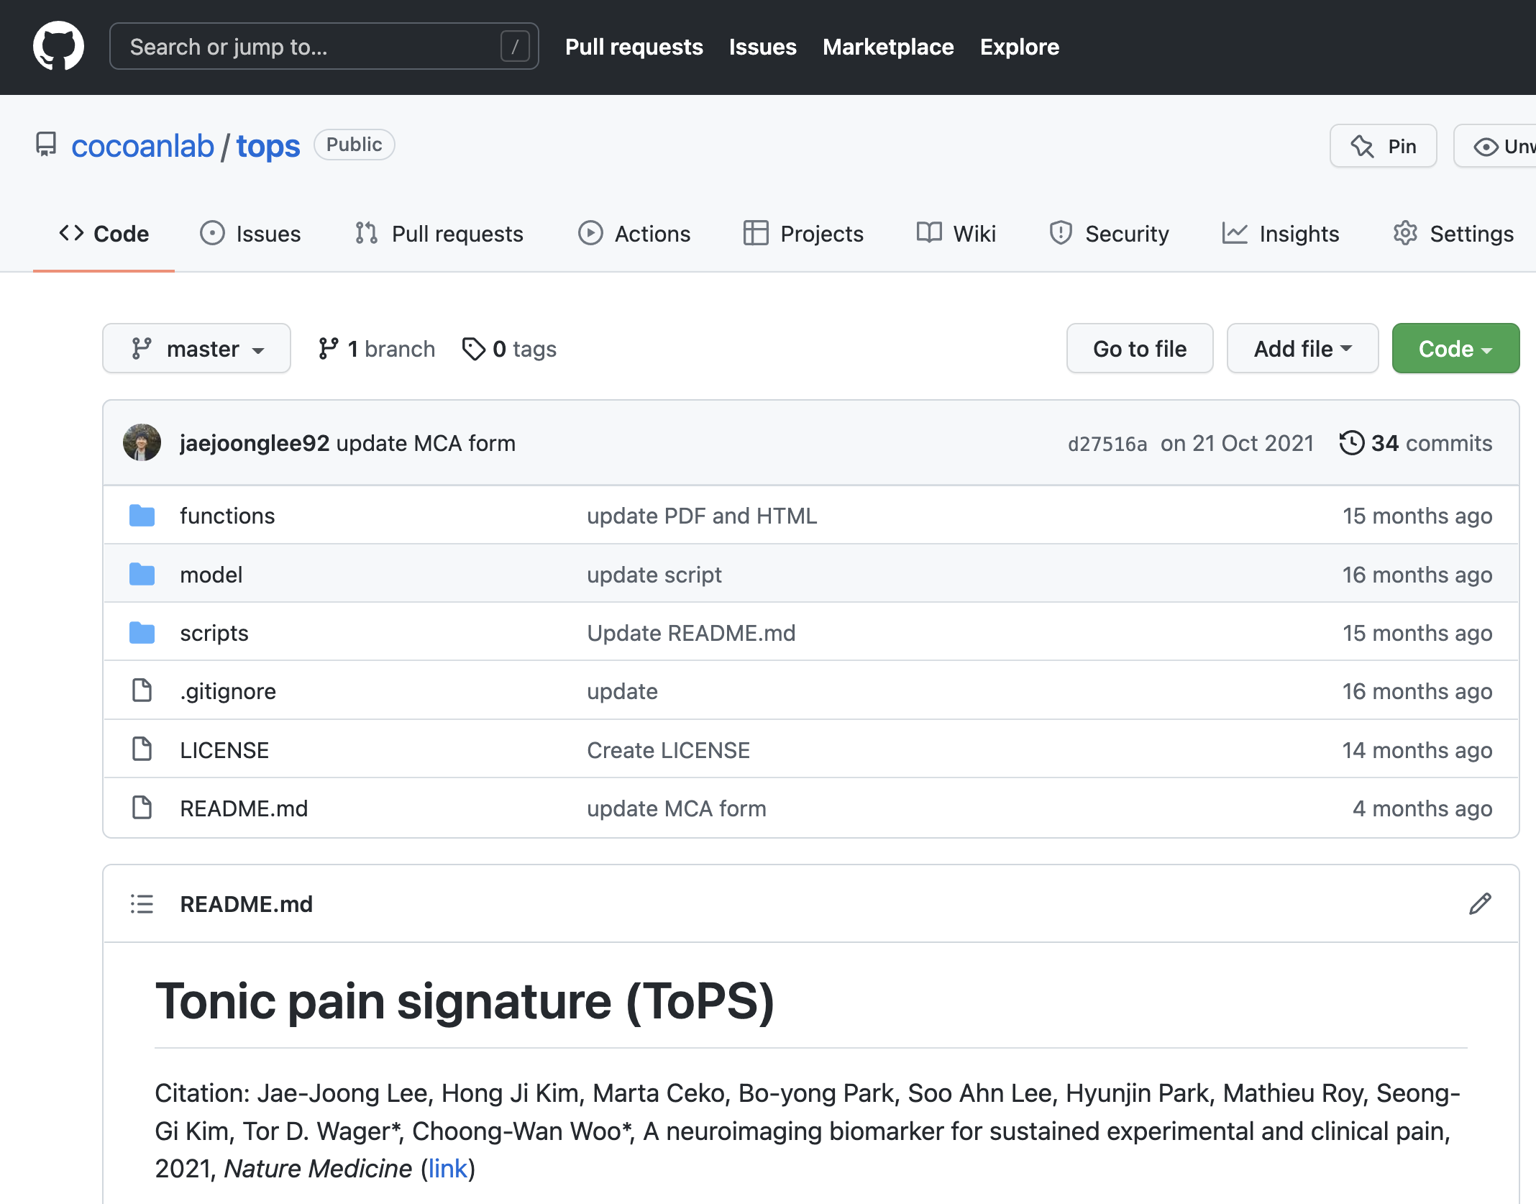
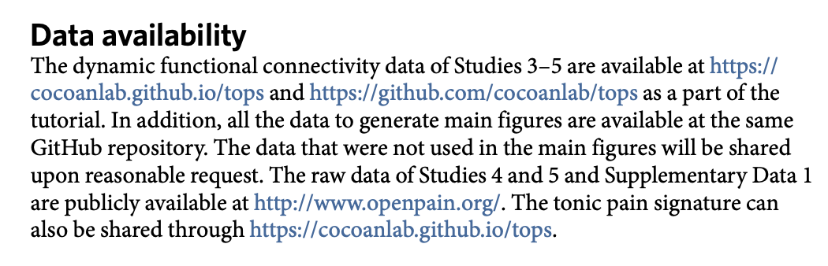
Lecture 01
For syllabus and files!
Most popular software development platform: version control, easy-sharing scripts and data, etc.
Everyone uses GitHub for the development, including Google, Facebook, etc.
More and more people are creating and sharing a GitHub repository for their research and publications:
E.g., Lee et al., 2021, Nature Medicine
CHOONG-WAN WOO | COCOAN lab | http://cocoanlab.github.io

Slide 12
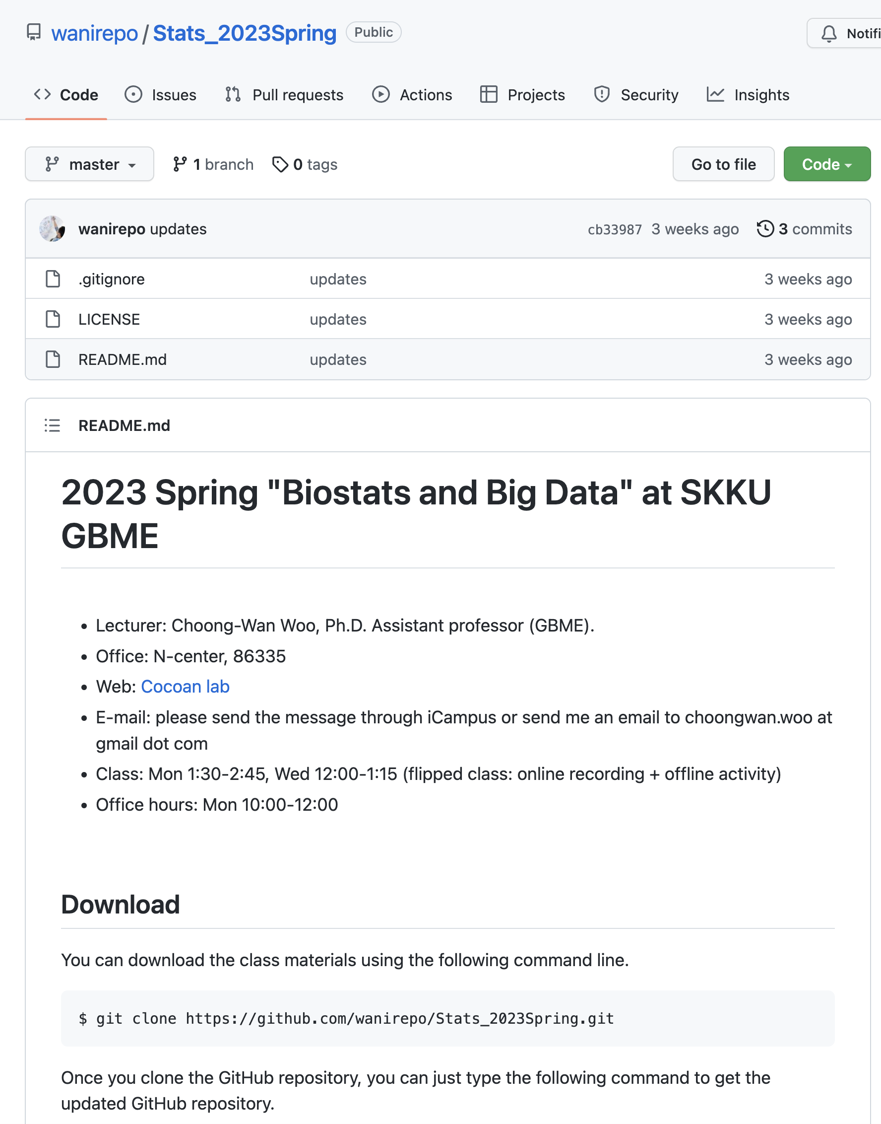
Lecture 01
Our class website: https://github.com/wanirepo/Stats_2023Spring
README.md is the syllabus.
Let’s visit the website and read the syllabus together.
CHOONG-WAN WOO | COCOAN lab | http://cocoanlab.github.io

Slide 13
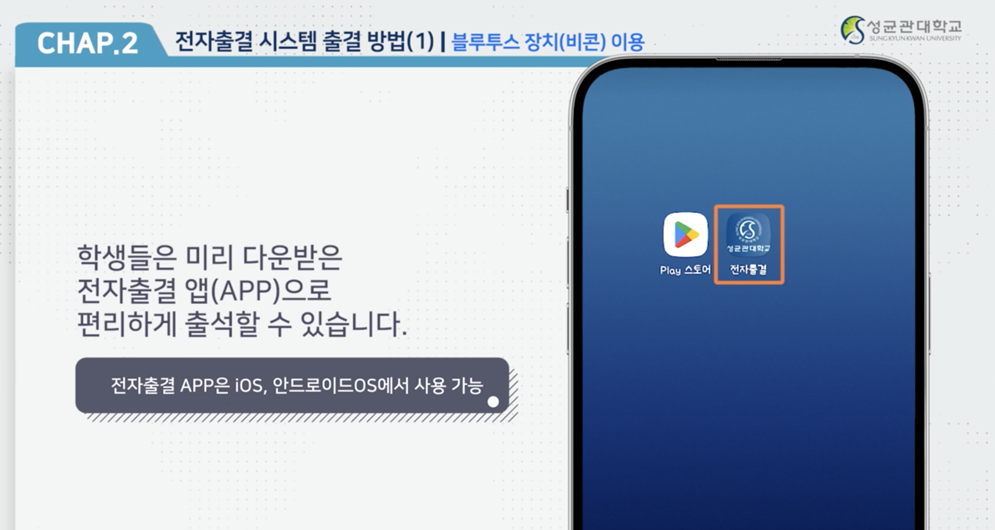
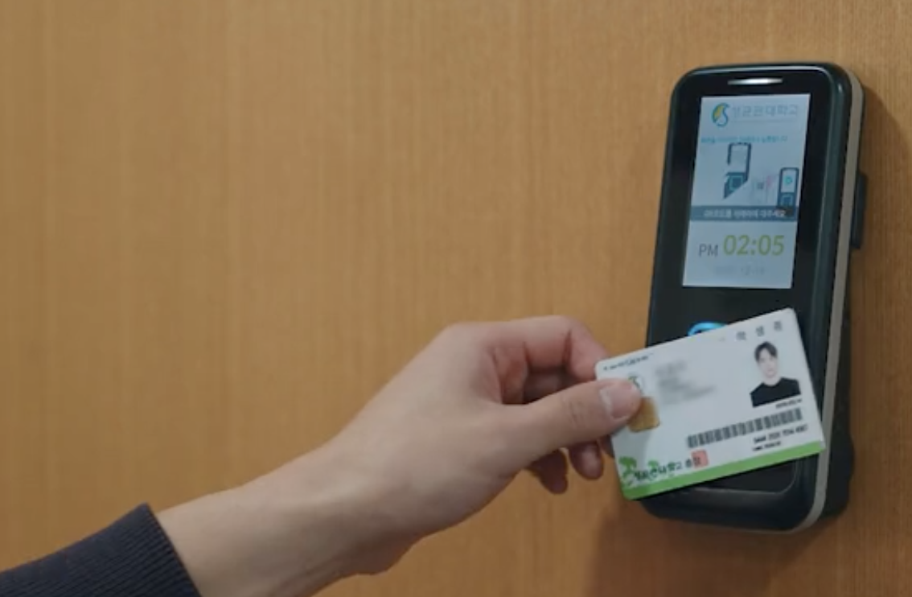
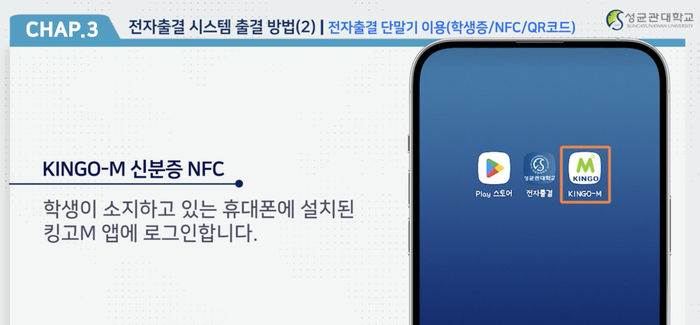
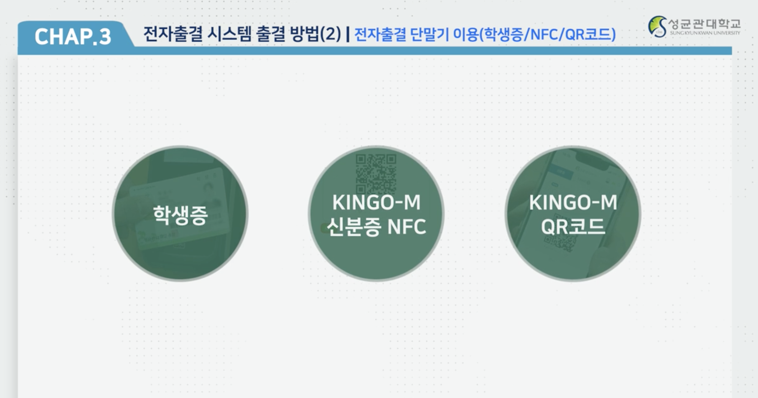
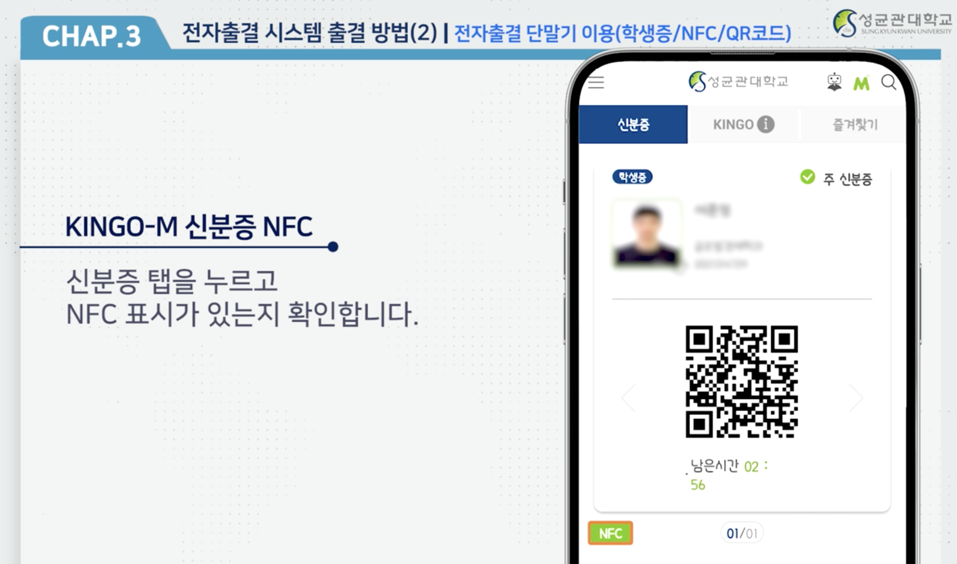
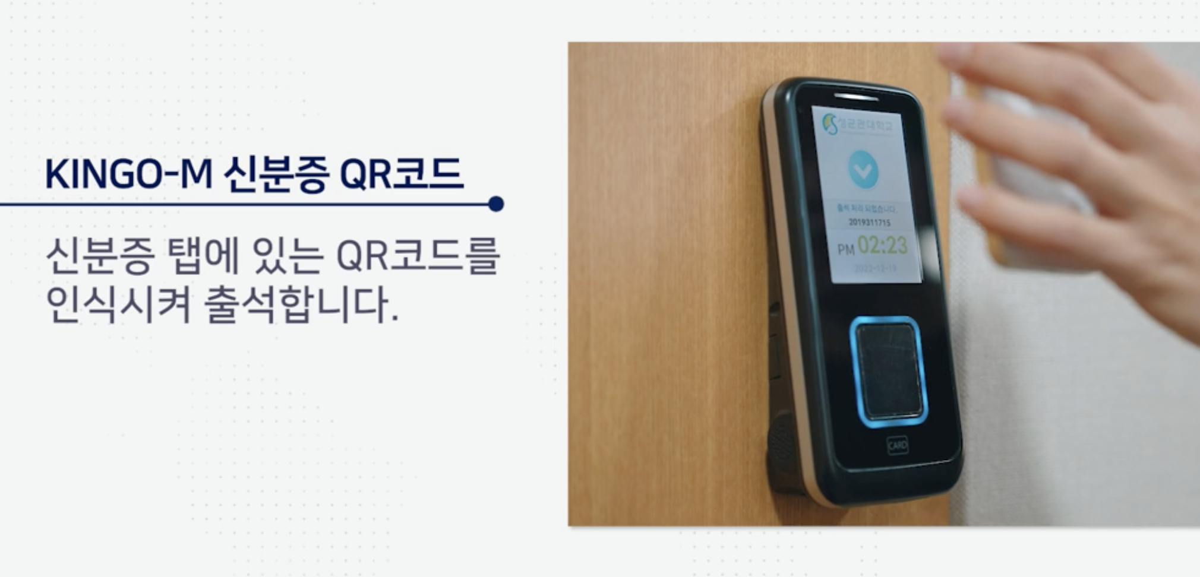
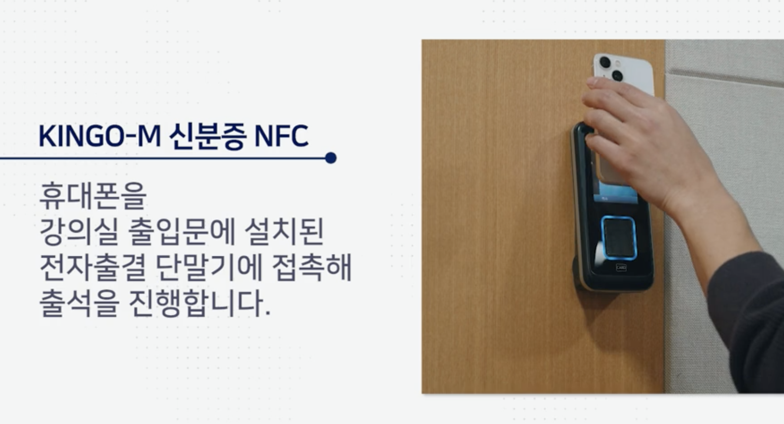
Lecture 01
Smart attendance
출석: 강의시간 5분 전~ 시작 후 10분
지각: 각의시간 +10분 ~ +40분
결석: +40분 이후 또는 미참석
CHOONG-WAN WOO | COCOAN lab | http://cocoanlab.github.io

Slide 14
Lecture 01
Team activity
Each class, you will form new teams depending on where you sit
4-5 members per team
잘 되어야 할텐데…
CHOONG-WAN WOO | COCOAN lab | http://cocoanlab.github.io

Slide 15
Lecture 01
To-do before the next class
Survey before the next class (3/6): https://forms.gle/DRUuAU6gpFW9tBSc9
Watch the first lecture [V01] Statistics and Data: https://www.youtube.com/watch?v=hkMrXhG0ot0
Next class: 3/6 Monday 1:30 PM here at 86120
If we decide to use slack, join slack using the following link: https://join.slack.com/t/wanistatspring2023/shared_invite/zt-1q2pgkwno-i72aYnl7SBZmq8TT_Av1dQ
CHOONG-WAN WOO | COCOAN lab | http://cocoanlab.github.io

